Slide 1
RECOMMENDATIONSYSTEM ON MOVIELENS DATA
Given a movies attributes and user ratings, design a robust recommendation system using content based and collaborative filtering approaches.

Slide 2
CONTENTS
1. DATA
2. EDA
3. FEATURE ENGINEERING
4. WEB SCRAPING
5. POPULARITY BASED RECOMMENDATION
6. CONTENT BASED RECOMMENDATION
7. COLLABORATIVE FILTERING
8. POTENTIAL NEXT STEPS

Slide 3
DATA
Client: GroupLens Research has collected over various periods of time and made available rating data sets.
Data:
tag – userId, movieId, tag, timestamp
rating – userId, movieId, rating, timestamp
movie – movieId, title, genres
Inspection:
Null Values: release date, imdb url
Pre-Processing: Format movie title by removing year

Slide 4
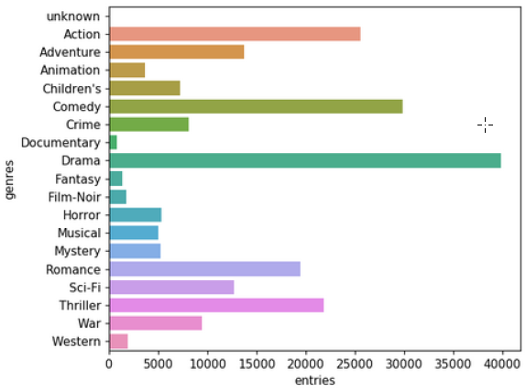
EDA
genre count
Most movies belong to ‘drama’ and ‘comedy’ genre

Slide 5
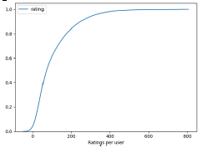
EDA
Ratings vs User - Cumulative Density Function
82% of the users have made less than 200 ratings while 18% of the users have rated more than 200 of them.

Slide 6
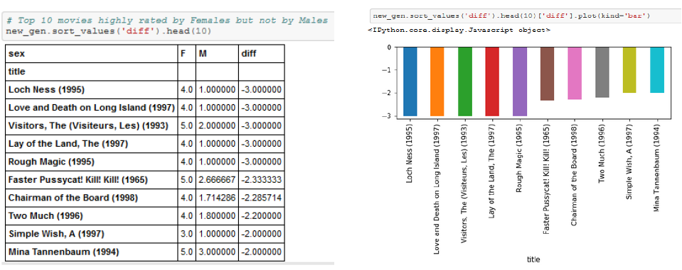
EDA
Top 10 movies highly rated by Females but not by Males
Loch Ness’, ‘Love Death and Long Island’ are the movies that were rated highly by females but not by males.
Note: Fantasy is overlapping genre for these movies

Slide 7
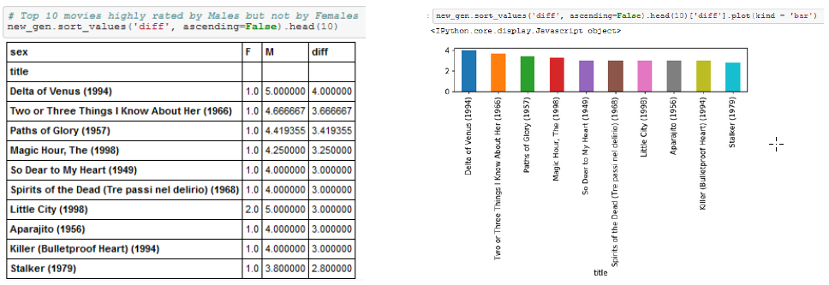
EDA
Top 10 movies highly rated by Males but not by Females
‘Paths of Glory’, ‘The Magic Hour’ are the movies that were rated highly by males but not by females.
Note: Drama is overlapping genre for these movies

Slide 8
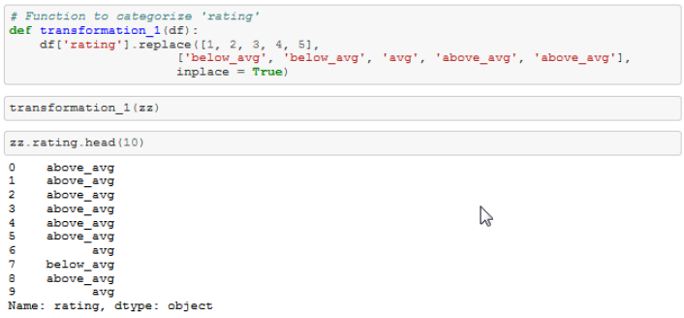
FEATURE ENGINEERING
Replacing ratings with below_avg, avg and above_avg:

Slide 9
WEB SCRAPING
Beautiful Soup:
Metascore, total votes, runtime, imdbid, tmdbid
TMDBSimple:
Tmdbid, cast, crew, tagline, description
Challenges:
Query Beautiful Soup using movie title
Query TMDBSimple using imdbid/tmdbid

Slide 10
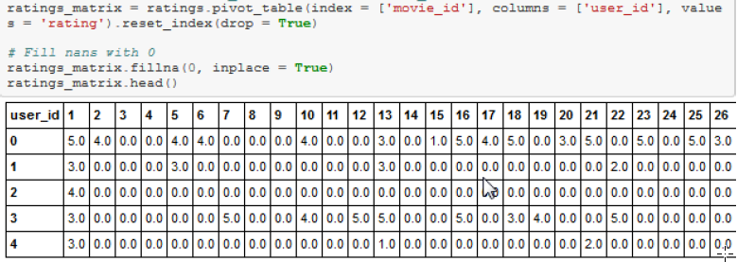
POPULARITY BASED RECOMMENDATION
Ratings matrix with movie_id as columns and user_id as rows and ratings as values

Slide 11
POPULARITY BASED RECOMMENDATION
Provided a movie title, extract the movie index.
Calculate pairwise distances (Cosine Similarity, Euclidean, Manhattan, Correlation) for every movie with respect to the input.
Sort movies descedingly
Return top 10 movies.

Slide 12
CONTENT BASED RECOMMENDATION
Description Based Recommendation
‘Overview’
‘Tagline’
‘Description’ = ‘Overview’ + ‘Tagline’
Tf-Idf Vectorizer
Cosine Similarity
Return top 10 similar movies.

Slide 13
CONTENT BASED RECOMMENDATION
Metadata Based Recommendation
Data Pre-Processinng:
Convert dictionary entries to list on ‘cast’, ‘crew’ and ‘keywords’
Create new columns –’cast size’, ‘crew size’
Select top 4 artists from cast [ lead actor, lead actress, supporting actor 1, supporting actor 2]
Strip spaces in cast and crew – This way engine will not confuse between Johnny Depp and Johnny Galecki.
Mention ‘Director’ 2 times to give it more weight relative to entire cast.

Slide 14
CONTENT BASED RECOMMENDATION
Keywords:
Not all words significant. Exclude the words that occur only once.
Stemming:
Words like ‘play’, ‘played’ and ‘playing’ can be stemmed to the word ‘play’. This process is called stemming.
Perform stemming on keywords.
Soup:
‘soup’ = ‘keywords’ + ‘cast’ + ‘director’ + ‘genres’

Slide 15
CONTENT BASED RECOMMENDATION
Filter movie selection:
Select movies that have cast size > 2 and crew size > 2
Count Vectorizer:
Create a count matrix and calculate the consine similarities.
Limitation: This recommendation system returns only the movies based on soup. It does not consider popularity.
Solution: We use the results returned from our Count Vectorizer (indices) and return the movies that are popular based on the IMDB's weighted average.

Slide 16

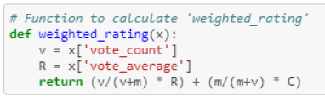
CONTENT BASED RECOMMENDATION
Weighted Average:
Use weighted average to sort and return top movies.

Slide 17
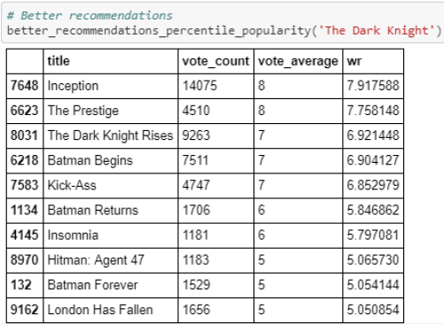
CONTENT BASED RECOMMENDATION
Movies recommended are highly emphasized on the director.

Slide 18
COLLABORATIVE FILTERING
Use 25% of the data (computational limittaions)
Select ‘user id’, ‘movie id’ and ‘rating’
Idea behind user and item similarity:
1. User similarity can be calculated by measuring 'pairwise distances' between ratings dataset.
2. For Item similarity, we have to transpose the 'ratings' data and then calculate the pairwise distances.

Slide 19


COLLABORATIVE FILTERING
User Similarity Matrix:
Item Similarity Matrix:

Slide 20
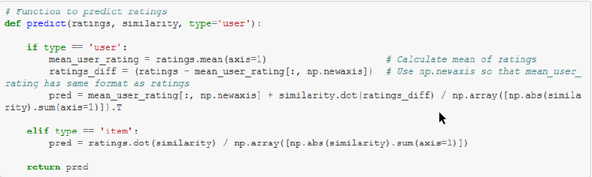
COLLABORATIVE FILTERING
Predict function:

Slide 21
POTENTIAL NEXT STEPS
For a linear column, there can be huge variance.
- Try normalize and standardize
Use 'word2vec'
Build a Hybrid Recommender

